Slide 1

Spring Boot @ConfigurationProperties example
Spring Boot @ConfigurationProperties is allows developer to map the entire property file into an object easily.
In normal spring framework, we use @Value annotation to inject property values one by one.

Slide 2

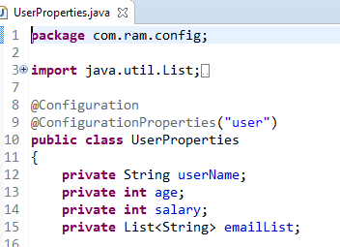
Spring Boot @ConfigurationProperties example
@ConfigurationProperties annotation helps to load a family of related properties, say in this specific case name spaced by the prefix conveniently named “user".
The approach Spring boot takes is to define a bean that can hold all the families of related properties this way
During runtime, all the properties will be injected to the related bean attributes.

